Slide 1
CAPER Center for Advanced Power Engineering Research
JOSHUA SMITH
Clemson University

Slide 2
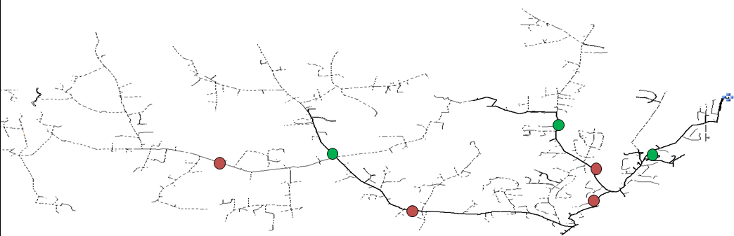
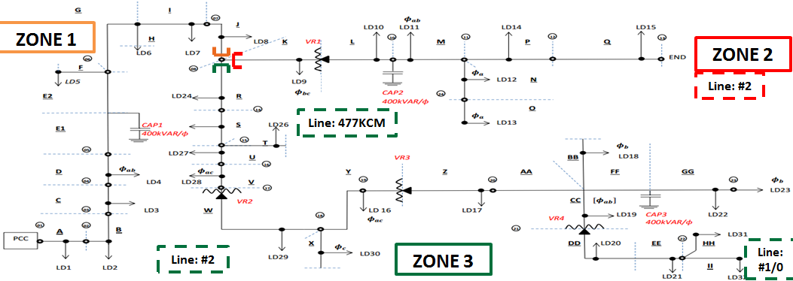
Introduction
Original cyme file
Simplified feeder

Slide 3
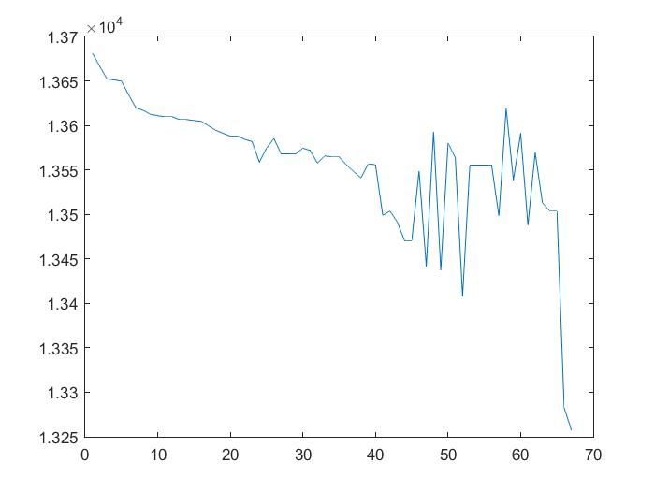
Simplified Circuit Development
LinesByPhase
Error: 2φ line to 3φ line
Loads
Master
Simulation using Matlab
Simplified Circuit
Full DSS Model
Coordinates
OpenDSS Help

